Slide 1
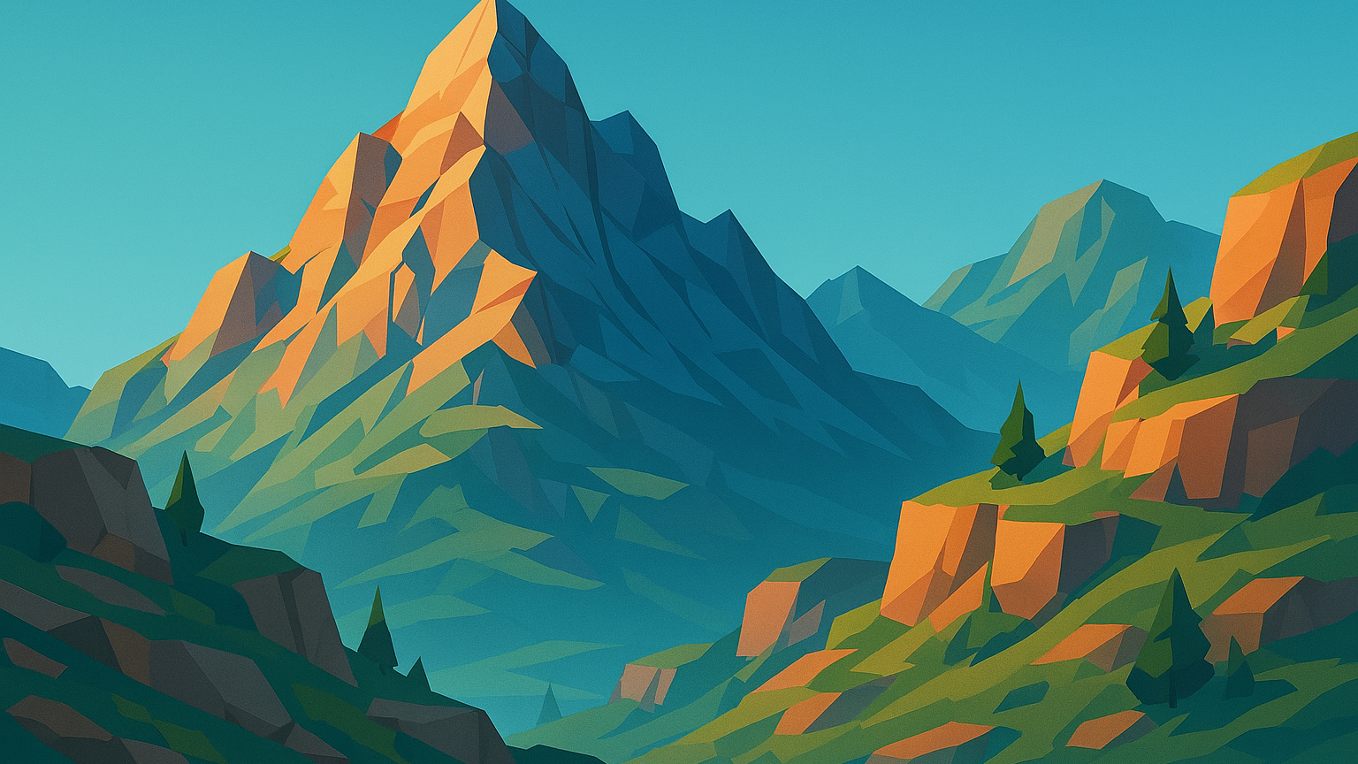
Risky Peak
Master movement. Outsmart gravity. Conquer the unknown.
Notes:
Welcome to our presentation on our new indie game called “Risky Peaks”

Slide 2
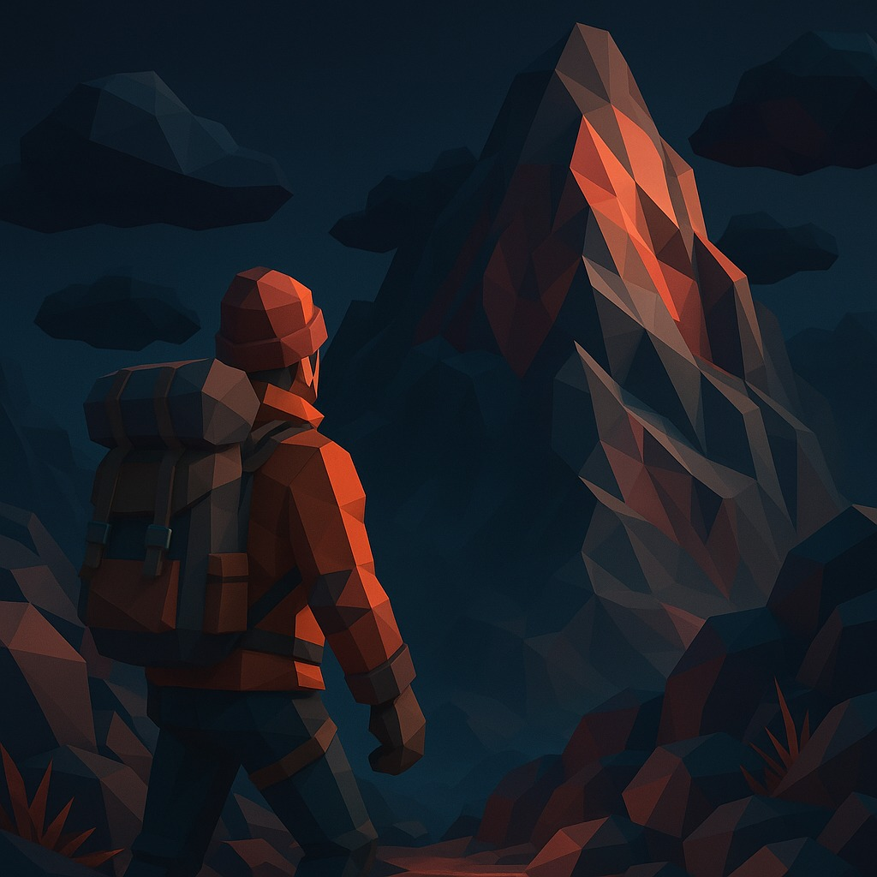


Statement
Risky Peak is a vertical adventure climber where every level is a choice between great risk and great reward.
"Risk it for a biscuit"
Notes:
“This game is about tension and mastery. Every climb feels earned, and every shortcut tempts you with risk.”
“Players explore layered levels with dynamic gravity and environmental hazards, unlocking paths and secrets.”
“Unlike typical platformers, this focuses on vertical progression, strategic shortcuts, and stamina-based challenges.”
“Fans of precision platformers and exploration-driven games will love the sense of accomplishment.”
“We want players to feel the thrill of climbing into the unknown, where every decision matters.”

Slide 3

What are you doing?
Navigate a treacherous mountain to rescue the person at the summit, balancing time, risk, and compassion.
Notes:
Core Objective: “Your mission is to climb the mountain and save the person at the top before time runs out.”
Player Choices: “Along the way, you decide whether to take risks and help stranded climbers. These choices shape the story.”
Endings: (3)
Good Ending: Save everyone and reach the summit in time.
Normal Ending: Save some, reach the summit in time -face the ghosts of those left behind.
Bad Ending: Fail to save anyone or run out of time—the person at the top turns hostile.
Emotional Hook: “Every decision matters: speed versus compassion, shortcuts versus safety.”

Slide 4

Why are you doing it?
Challenge-based climbing games are popular (e.g., Getting Over It with Bennett Foddy).
We wanted to evolve the genre by adding meaningful narrative choices.
It’s not just about reaching the top—it’s about decisions that shape the journey.
Notes:
We’re doing this because climbing isn’t just movement - it’s a test of skill and judgment. Every decision matters, and that tension makes success feel earned. And honestly… we’re also doing it because we have to… and we figured climbing a mountain was easier than getting a bad grade.

Slide 5
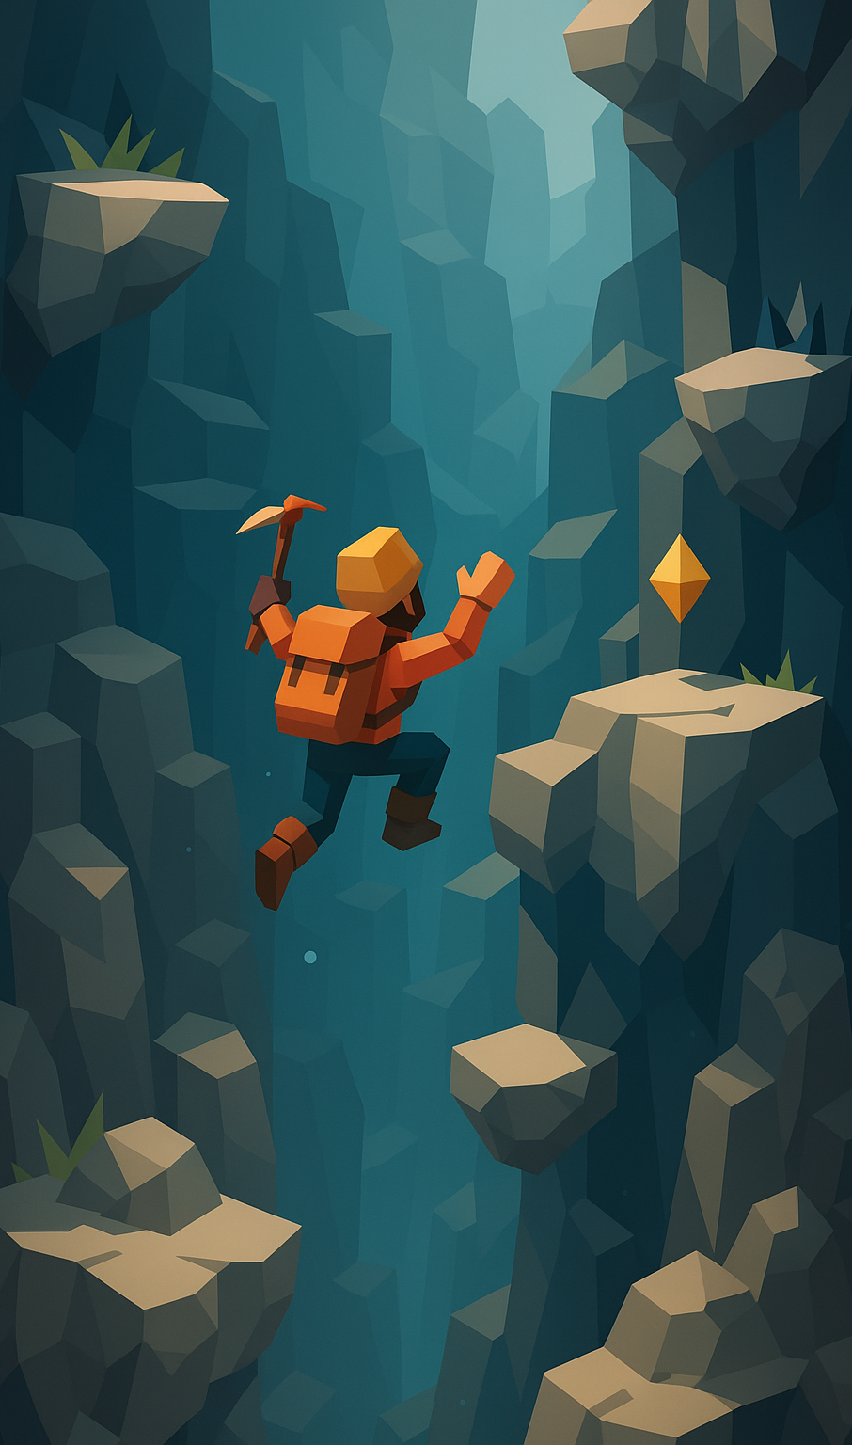
How are you doing it?
Advanced climbing mechanics for fluid, skill-based movement.
Risk/reward shortcuts that challenge timing and stamina.
Environmental storytelling through paths and items.
Notes:
PADRAIC
Slide 2: Advanced Climbing Mechanics
Key Features:
Responsive controls with momentum and grip feedback
Variable ledge types (e.g., crumbling, slick, shifting, sticky, hot)
Wall runs, mantling, and dynamic transitions
Risk/Reward Shortcuts
Goal: Introduce meaningful challenge through optional paths
Key Features:
High-risk routes with stamina or timing constraints
Hidden ledges, collapsing footholds, or wind gusts
Environmental Storytelling
• Abandoned camps, broken gear, or murals along paths
• Shortcut routes that reveal lore or character backstory
• Item placement that hints at past events or future threats

Slide 6
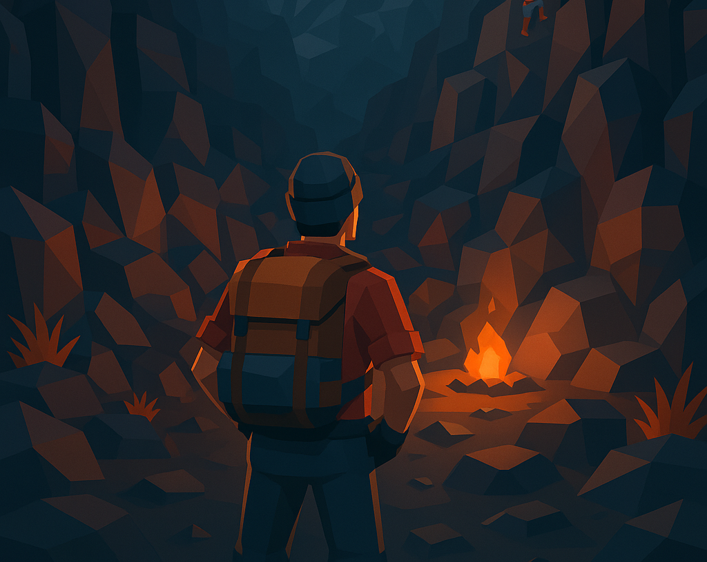
Summary of key facts
PC and Console Based
Genre is platform game
Expected Release Date Second week in Janurary
Cosmetics, DLC
There can be 2 players on the mountain
Medium Length
Game Programmer – Padraic
Creative Director – Adam
Cinematography - Chris
Challenging climbing platformer with risk and reward with intuitive mechanics
Notes:
-Control sceme designed for Controllers but also created for keyboard. The inputs are more difficult the harder the jump, adding an element of risk to the games jumping
-the game is a platformer if you fall, its unforgiving but exilerating
We hope to release in the second week of janurary, just before the anuual GamerFest in Dublin, in hopes to present it there and playtest to get some community and investors
The cosmetics in the game are stricly cosmetic that are paid for with real money, all progresive and game changing items and clothes will be earnable throughout the game play
Two players can play at a time, to help story and eachother, ye can aid eachother in jumps to encourage multiplayer co-op
Our Team, game programmer padraic, (explain padraic) creative director adam (explain adam)cinematography Chris (explain chris)

Slide 7
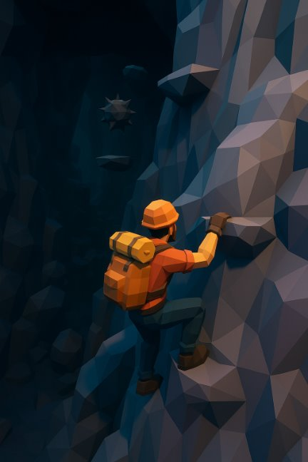
Specific features Gameplay
Timed levels
Risk-based paths from (all lead to same end of level)
Higher risk = level complete faster - higher score
Rewards precision from the player
Items to aid player (clothing, equipment, tools)
Failing risky paths = player falling back down and losing time
Notes:
“Gameplay revolves around precision and decision-making. Every level is a race against time — you choose your path: long and safe, or short and risky. The controls are physics-based, so every movement feels earned. As you climb, frost, wind, and vision changes force you to constantly adapt your rhythm.”

Slide 8
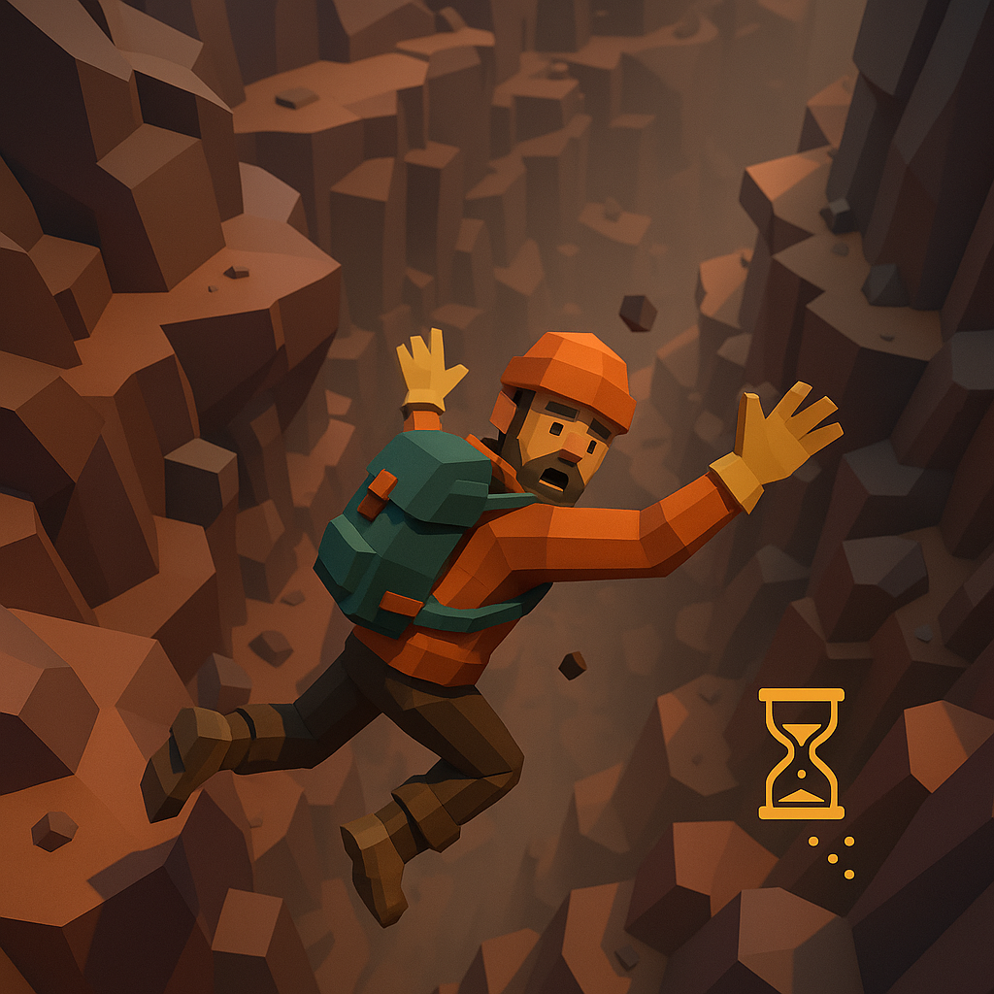
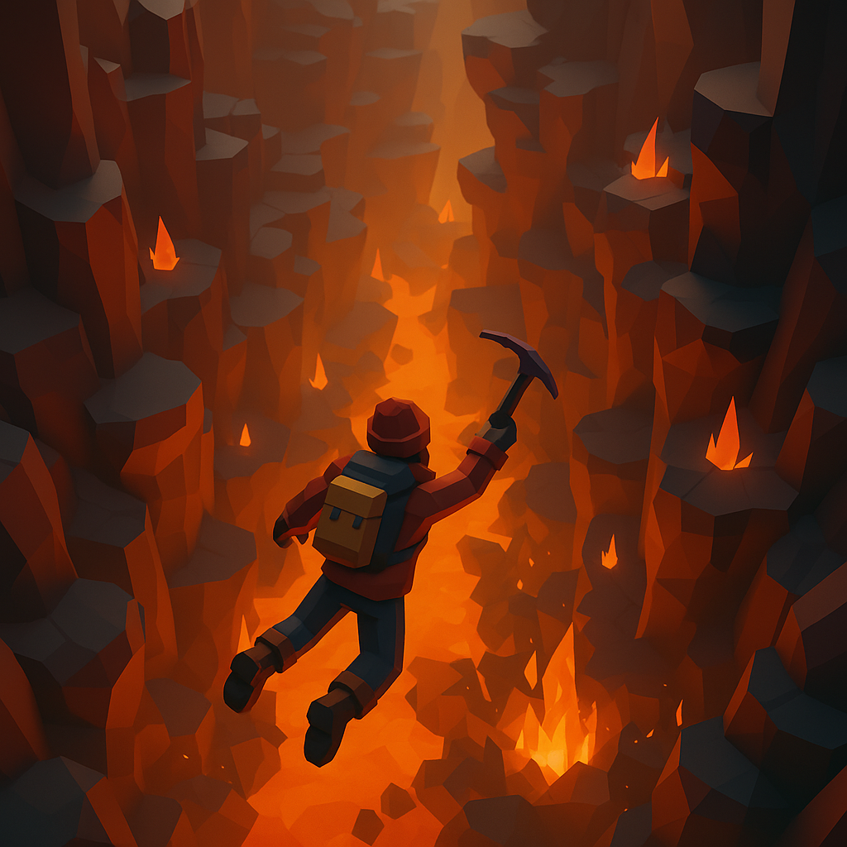
Specific features Combat
No direct combat
Environment is the enemy (frostbite, clouds, birds)
Using different tools for different scenarios
Fighting against time
Risk saving time or fall victim to your own choices
Notes:
ADAM
“There’s no traditional combat system. Instead, the environment itself fights back — falling rocks, aggressive birds, and freezing winds become your opponents. Players must use timing and tools, like upgraded ice axes or ropes, to survive these hazards. It’s about endurance over aggression — a battle against nature.”

Slide 9
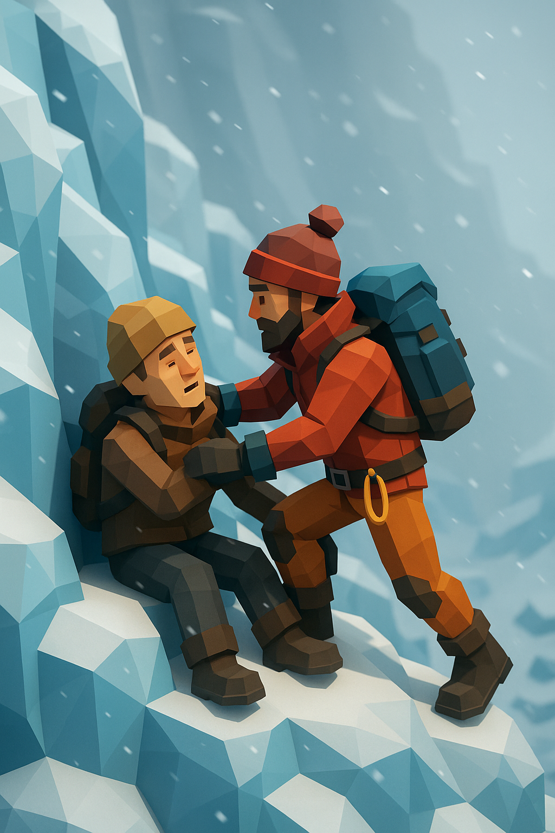

Specific features Storyline
Professional rock climber protagonist + paramedic
Stranded survivor goal at summit
Multiple endings (Ending/story is score dependant)
Notes:
“You play as a professional climber sent to rescue a missing mountaineer. The story unfolds through the climb itself — weather shifts, equipment damage, and brief encounters hint at the struggle of those who failed before you. Reaching the summit in time determines which ending you unlock — success, failure, or sacrifice.”

Slide 10
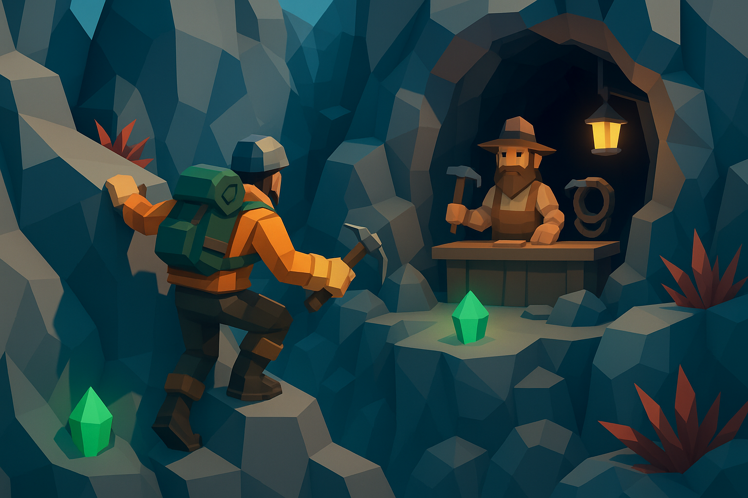
Specific features Main Characters
Main Character (player) - professional climber and paramedic
Stranded climbers who will give you bonuses (time, xp, gear, items) if you rescue them
Shopkeeper (NPC) who displays items & prices based on how difficult the last level was
Trapped climber at the summit - main objective

Slide 11
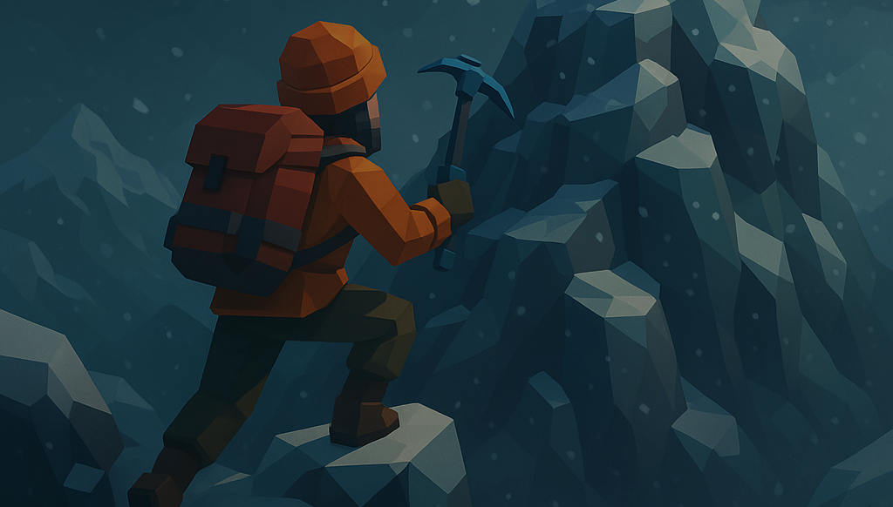
Thank you
Creators:
Adam Christensen
Padraic Coffey
Christopher Bolger
Images in this presentation were generated by ChatGPT

